Slide 1

HARMONY PRIMARY SCHOOL
LOGO COMPETITION

Slide 2
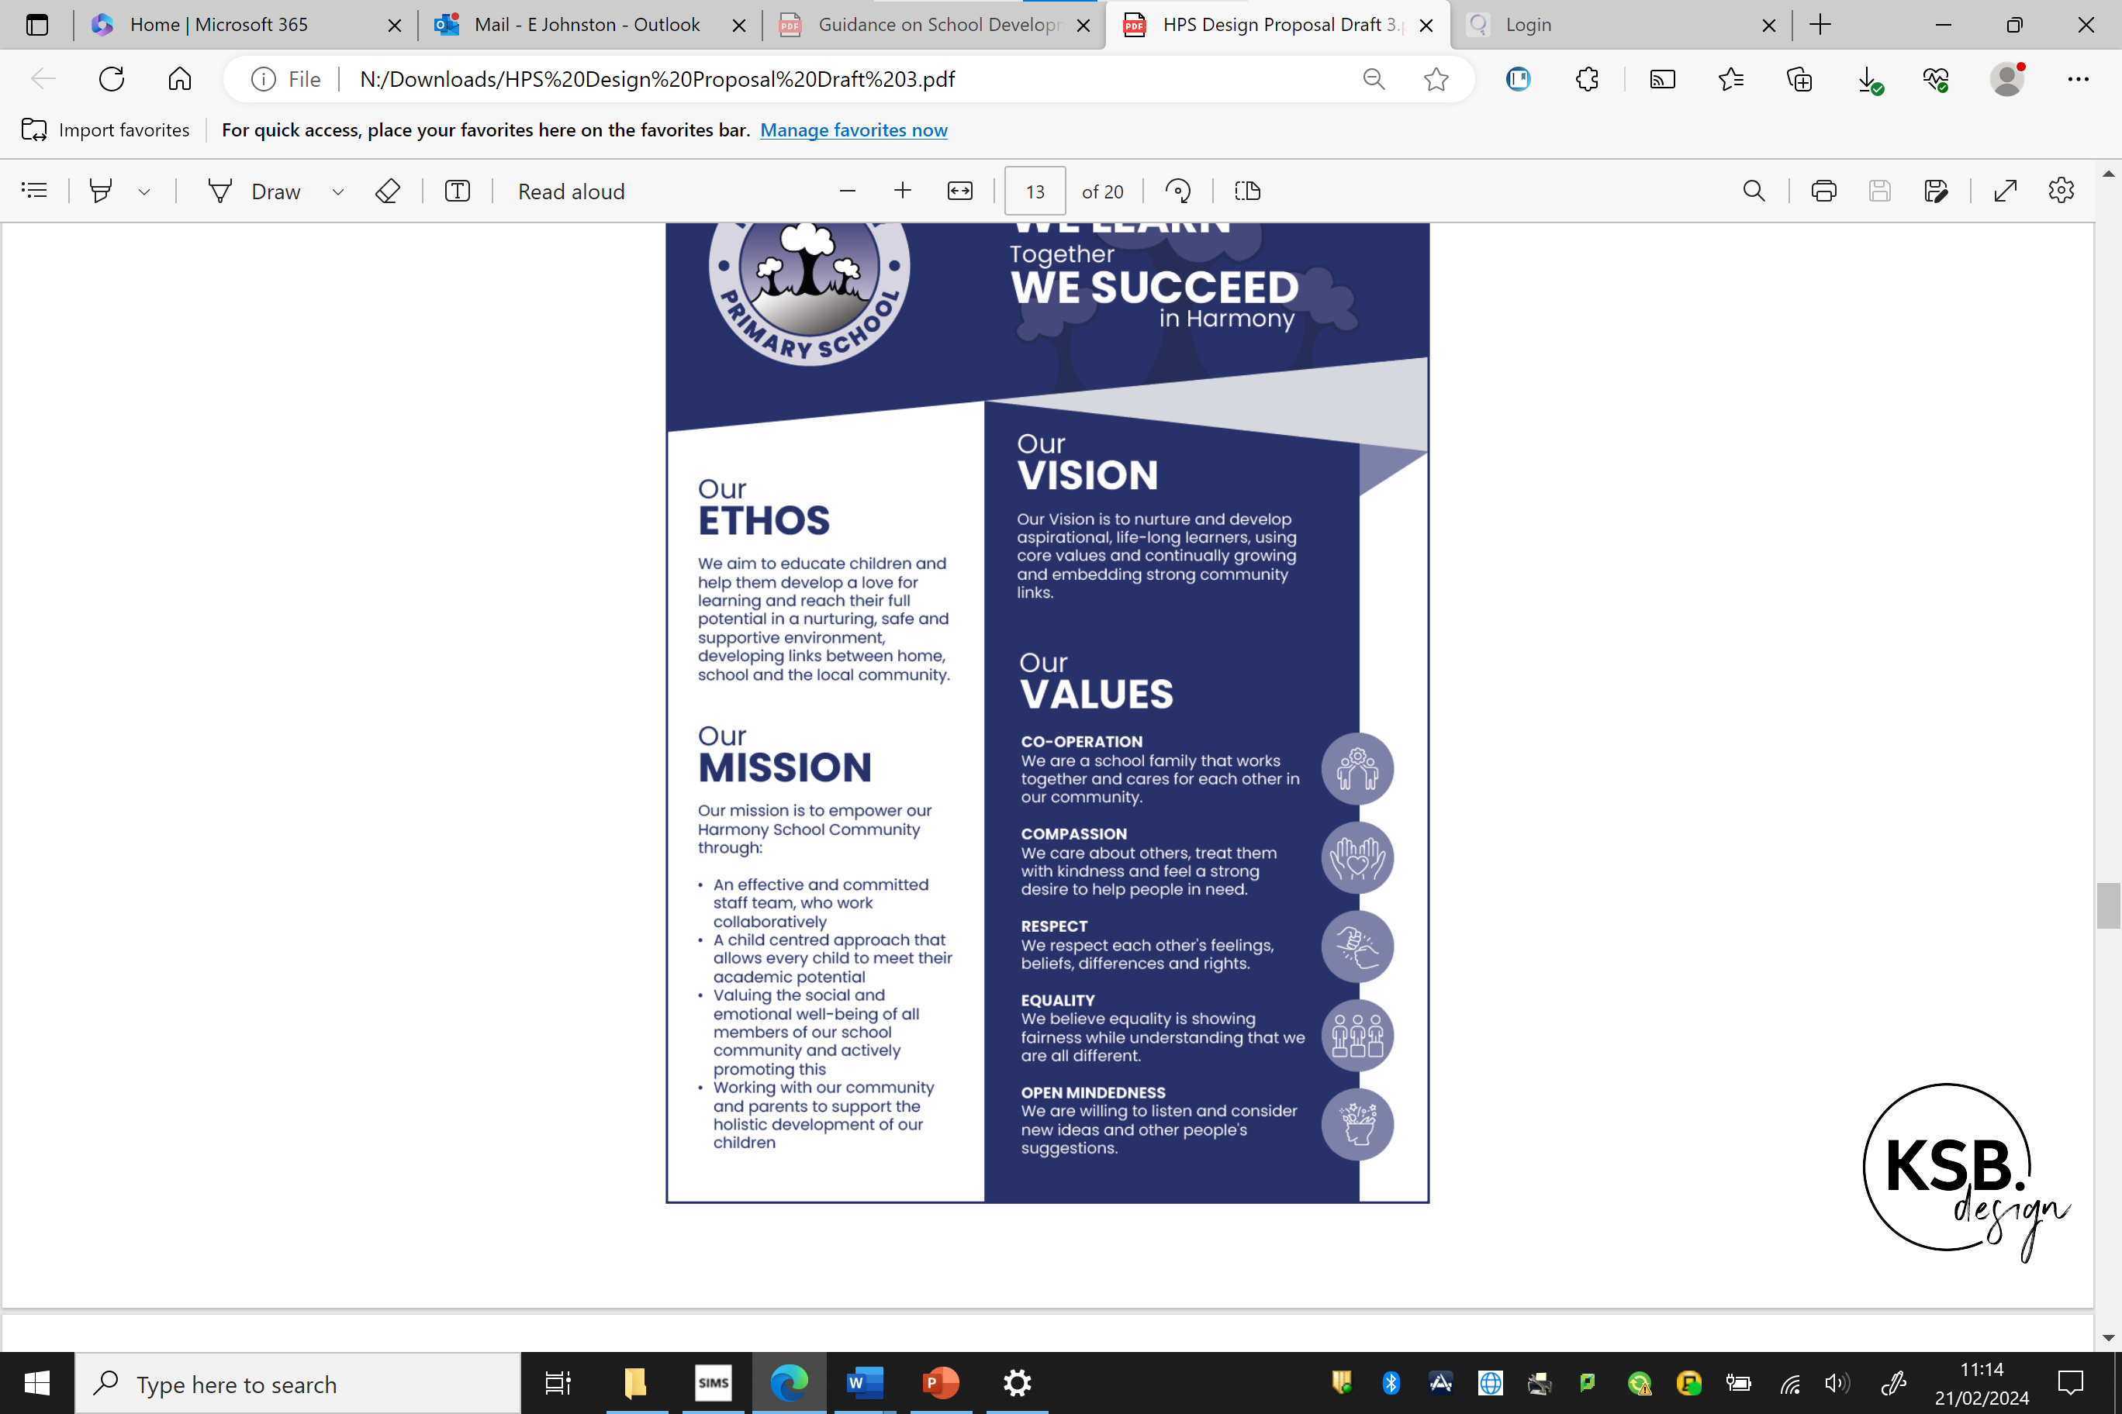

Slide 3


Slide 5
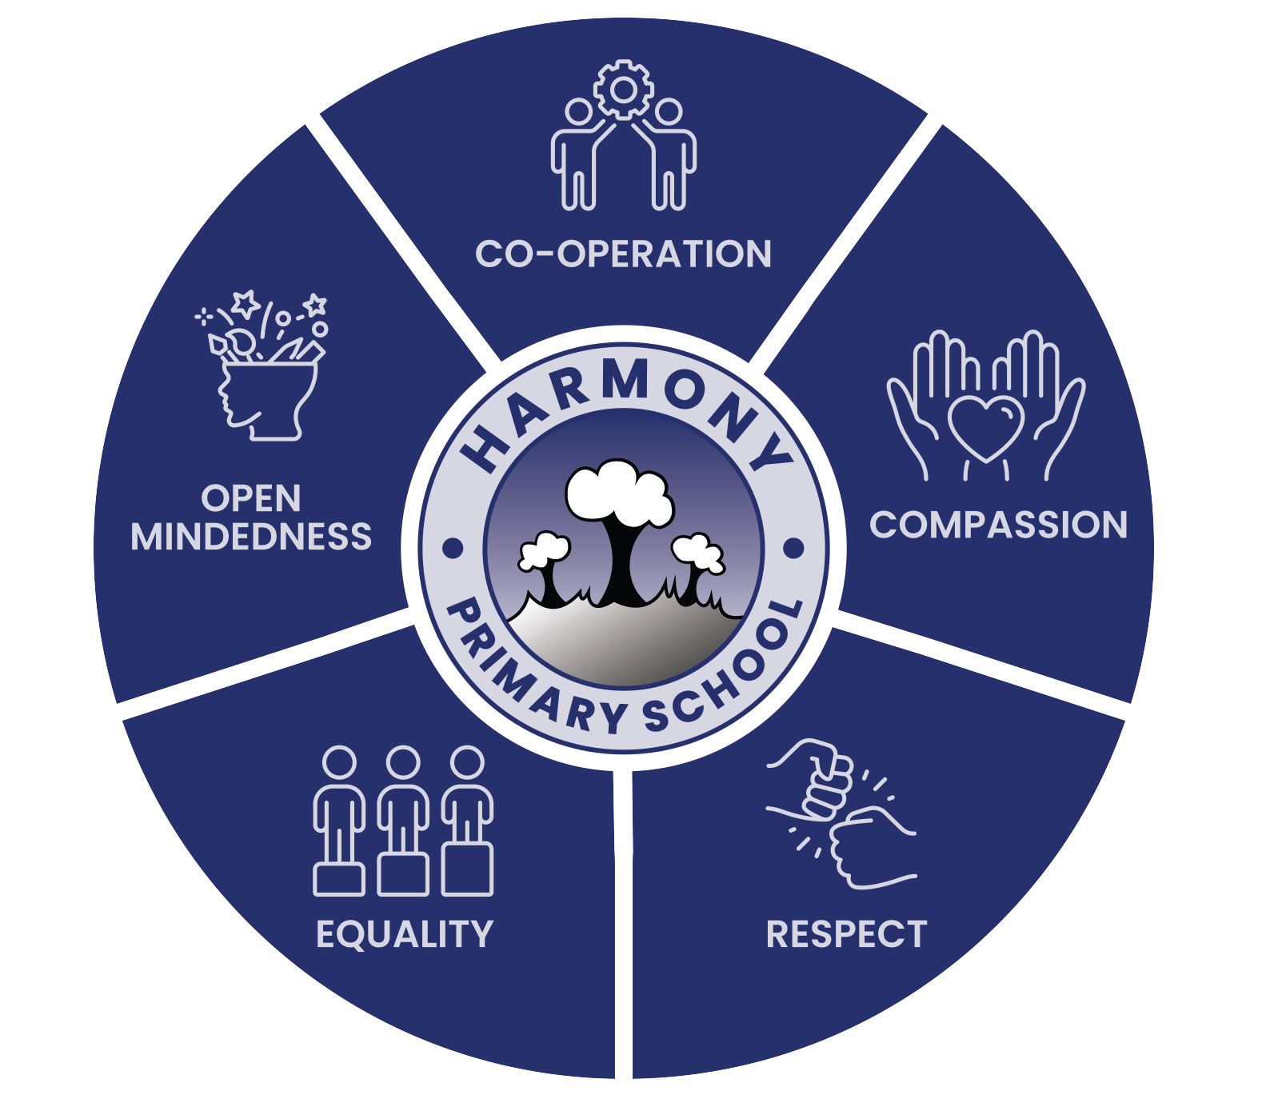
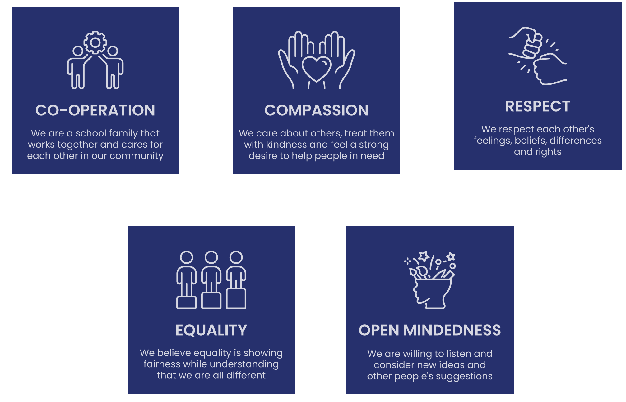
SCHOOL VALUES

Slide 6

The winner is

Slide 7
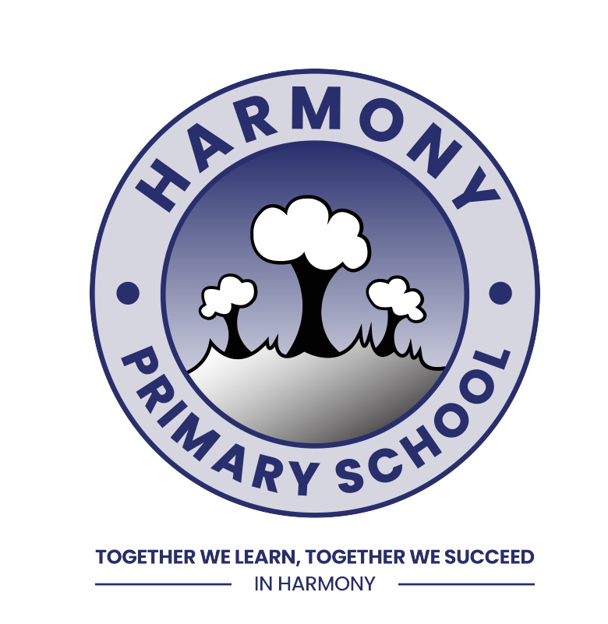
Harmony Primary School
JORDYN BEATTIE PRIMARY 5 (Miss Beggs)

Slide 8


